Slide 1
10 Tips for Creating Accessible Course Content
Ann Marie VanDerZanden, PhD
Director, Center for Excellence in Learning and Teaching
Louis Thompson Distinguished Undergraduate Teacher
Professor of Horticulture
Laura Bestler, PhD
Program Coordinator, Center for Excellence in Learning and Teaching
10 Tips for Creating Accessible Course Content by Center for Excellence in Learning and Teaching (CELT), Iowa State University is licensed under a Creative Commons Attribution-NonCommercial-ShareAlike 4.0 International License.
Notes:
10 Tips for Creating Accessible Course Content

Slide 2
Presentation Overview
Why make online course content accessible?
Guiding questions to inform course design
10 tips for creating accessible online course content
Next steps
Notes:
Agenda
Why?
Questions to inform course design
The 10 tips
Next steps

Slide 3
Reactive
Proactive
Accessibility is not just about providing accommodations when requested.
Accessible courses and course content anticipate the potential needs of diverse learners, and remove barriers or provide alternatives in advance.
Notes:
Be proactive, not reactive.
It’s not just about providing accommodations when requested. Waiting to react may be too late. Accessible courses and materials anticipate the possible needs of diverse learners and remove barriers or provide alternatives in advance.

Slide 4
Questions to Inform Course Design
How do the course format and the course content support accessibility or limit accessibility?
What prior technology knowledge/skills will the learner need to be successful?
Notes:
Questions to Inform Course Design
How do the course format and the course content support accessibility or limit accessibility?
What prior technology knowledge/skills will the learner need to be successful?

Slide 5
10 Tips
Notes:
Now, what you have been waiting for… 10 Tips for Creating Accessible Content

Slide 6
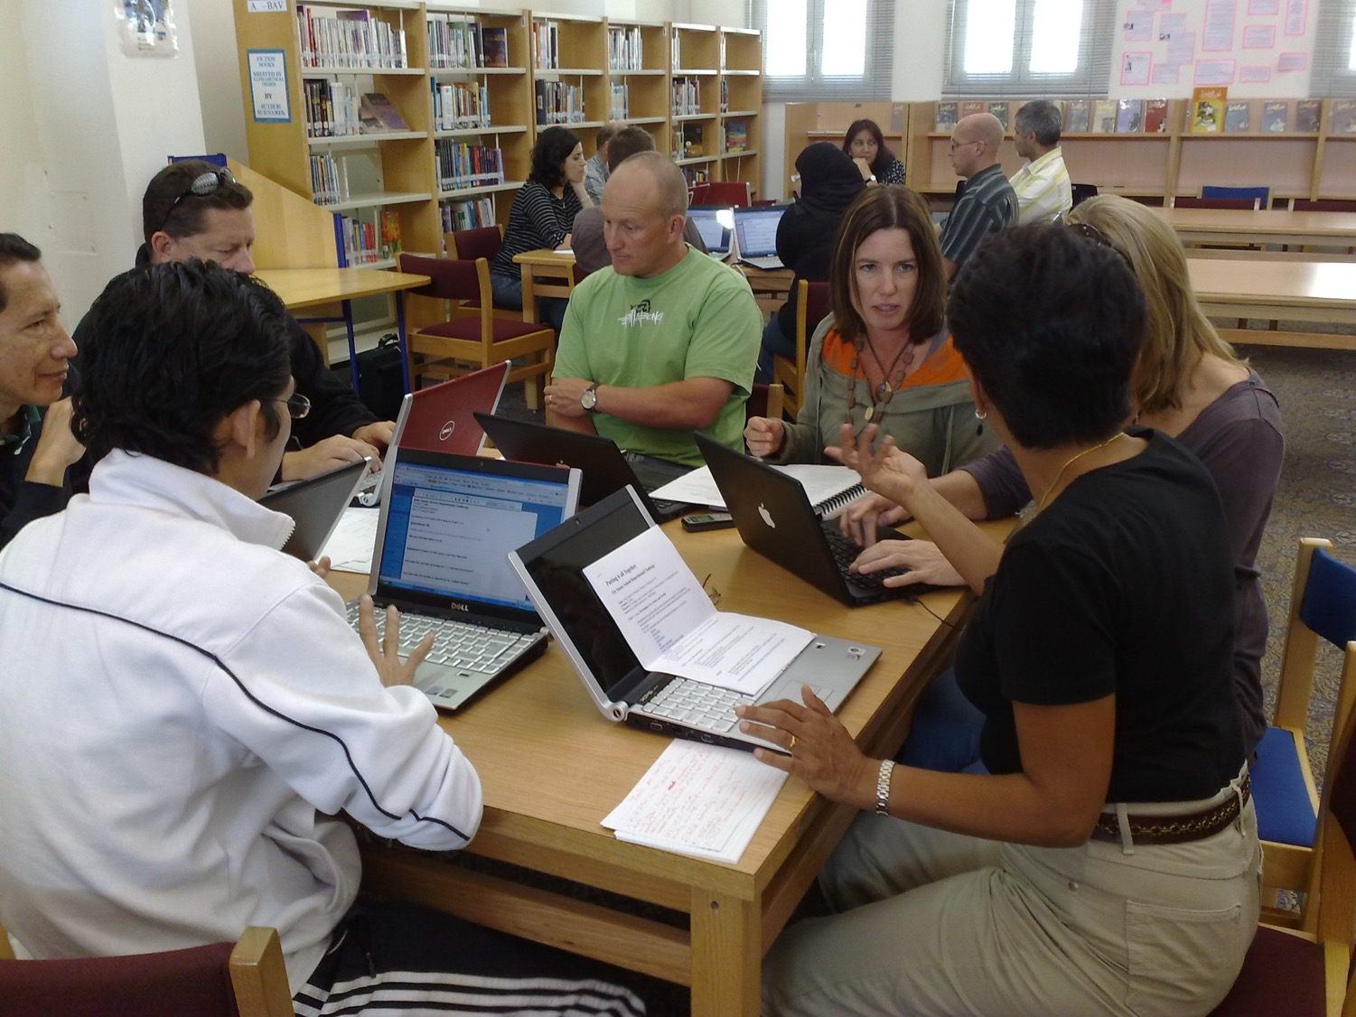
Tip 1: Take time to Plan an Online Teaching-Learning Strategy
Notes:
Tip 1: Plan your Online Teaching-Learning Strategy - what questions will you ask when designing your online course content.

Slide 7
Course elements (activities, assessments, etc.) follow a consistent structure/routine throughout the course.
Module 1
video
overview
components
PowerPoint slides
Lecture
goes to
Module 2
Assignments
Resources
process
online discussion
Module 3
Module Quiz
task
Notes:
Course elements (activities, assessments, etc.) follow a consistent structure/routine throughout the course.

Slide 8
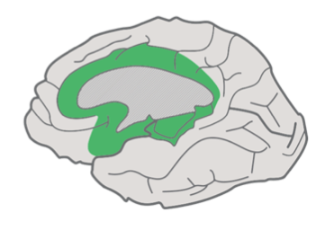
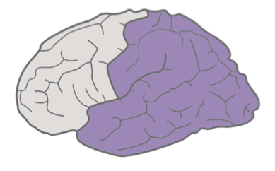
Universal Design for Learning (UDL)
Student activities are varied and take into account different learning styles.
Affective networks:
Recognition networks:
Strategic networks:
The Why of Learning
The What of Learning
The How of Learning
Engagement
For purposeful, motivated learners, stimulate interest and motivation for learning.
Representation
For resourceful, knowledgeable learners, present information and content in different ways.
Action & Expression
For strategic, goal-directed learners, differentiate the ways that students can express what they know.
Notes:
Ask yourself:
How am I taking into account different learning styles?

Slide 9
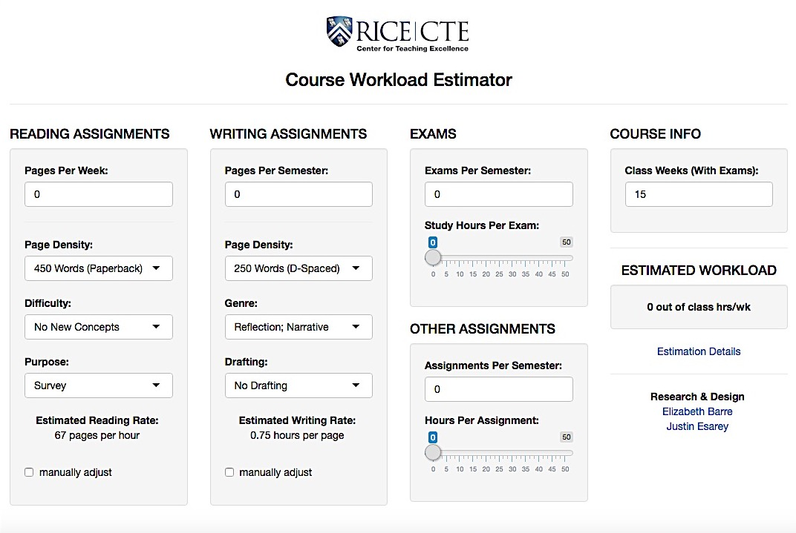
Students have adequate time to complete activities and assessments.
Notes:
Ask yourself:
How am I ensuring students have adequate time to complete activities/assessments?
Students have adequate time to complete activities and assessments.
Consider using: Rice University’s Course Workload Estimator: http://cte.rice.edu/workload

Slide 10
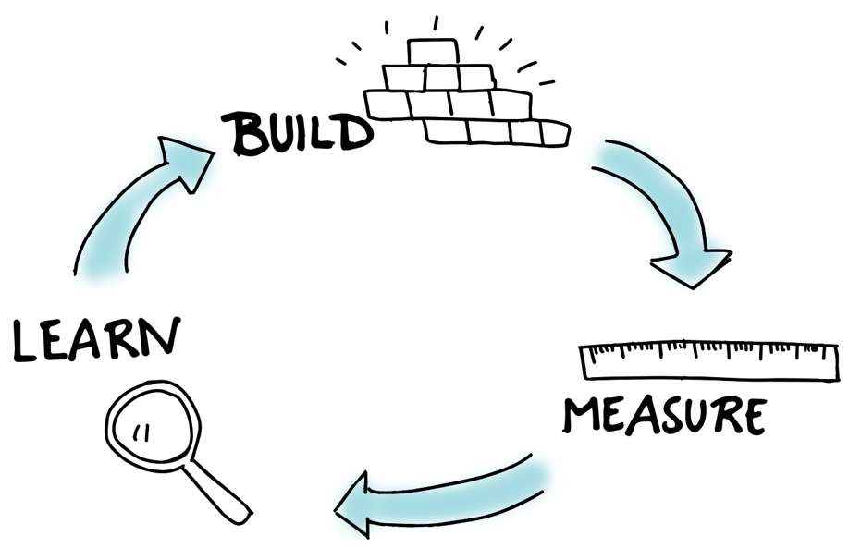
Instruction and learning activities allow for adjustment based on student feedback and need.
Notes:
Ask yourself:
How can I allow for adjustment of instruction based on student feedback and needs?
Activities allow for adjustment based on student feedback and need.

Slide 11
Tip 2: Use Constructive Course Alignment
Notes:
Tip 2: Constructive Course Alignment
Constructive alignment in teaching links the constructivist theory of learning (where students link new material to previous knowledge and experiences, and extrapolate to future understandings) with outcomes-based teaching. Implementing constructive alignment in course design results in explicitly linking teaching and learning activities, to classroom assessments and evaluation, to course learning objectives, and ultimately to course learning outcomes.

Slide 12
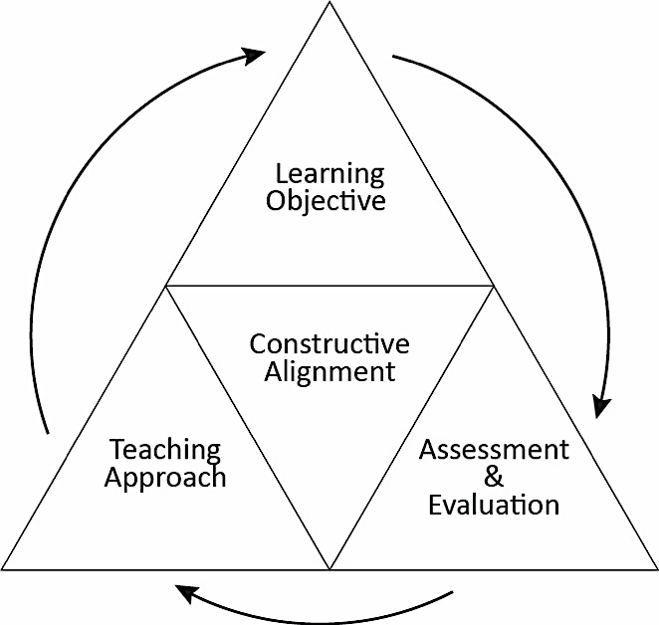
Constructive Alignment
CELT’s course alignment website: http://bit.ly/coursealignment
Notes:
Constructive alignment shows the relationship between learning objectives, assessment and evaluation strategies, and teaching approaches. CELT’s course alignment website: http://bit.ly/coursealignment

Slide 13
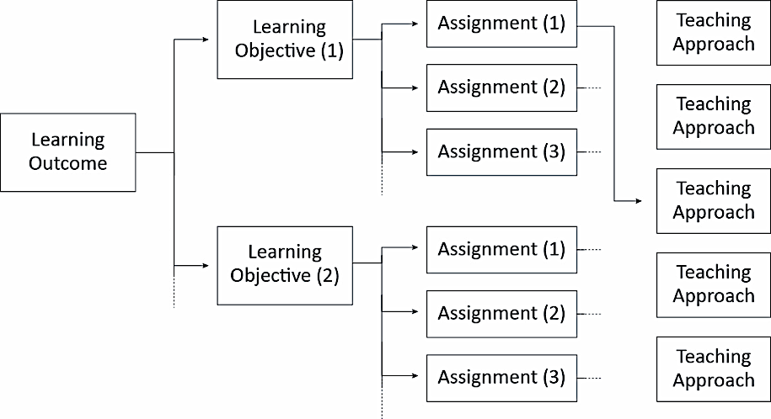
Connecting Outcomes to Assignments
Notes:
Start with the end in mind
Consider including this type of flowchart, specific to your course, in the course syllabus to help students see the connections between course assignments and learning outcomes. This is often called a graphic syllabus and also supports the concept of transparent teaching.
What are the overall course learning outcomes? Another way to think of the outcomes is to consider them as “enduring understandings”. If you had the chance to ask students six months after completing your course what they learned from the course, ideally they would be related to the course learning outcomes.
This can serve as design scaffold that you can apply as you are redesigning an existing course or designing a new course from scratch.

Slide 14
What course goals, skills, concepts (if any) may be an obstacle for students with:
visual disabilities?
auditory disabilities?
cognitive disabilities?
motor disabilities?
English as a second language?
Notes:
When you are developing your course design – consider this:
What course goals, skills, concepts (if any) may be an obstacle for students with:
Students with visual disabilities? auditory disabilities? cognitive disabilities? motor disabilities? English as a second language?
Any fundamental challenges to accessibility based on course outcomes have been addressed with the college instructional designers or CELT.
If further consultation is needed, request a consult with web accessibility team (Digital Access).

Slide 15
Tip 3: Develop Assessments & Evaluations to Support Course Learning Outcomes
Notes:
Tip 3: Developing Assessments and Evaluation

Slide 16
Assessment and Evaluation
Assessment
Ongoing
Positive
Individualized
Provides feedback
Both
Require criteria
Are evidence driven
Evaluation
Provides closure
Is judgmental
Is applied against standards
Shows shortfalls
Notes:
Once learning objectives are established, the next step is to create assessment and evaluation tools that will allow you to determine if students have accomplished/achieved a learning objective. This visual representation illustrates the relationship between assessment and evaluation. Using a combination of assessment (not graded) and evaluation (graded) approaches provides students a variety of opportunities to show their mastery of the course content.

Slide 17
Tip 4: Use the Quality Matters Framework
Notes:
Tip 4: Use the Quality Matters Framework

Slide 18
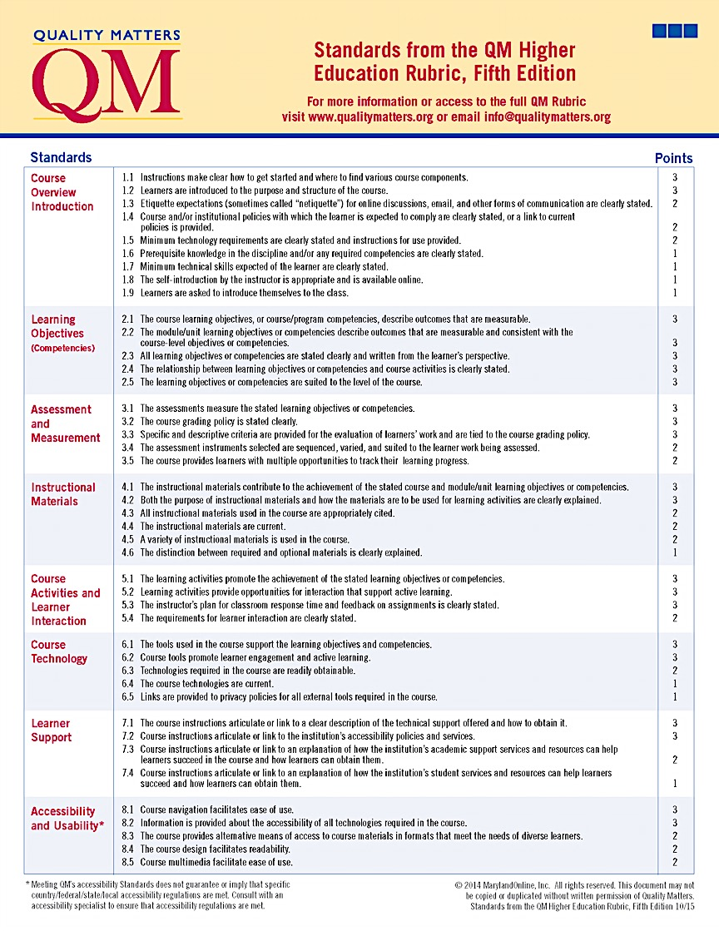
What is Quality Matters?
Learner-Centered Course Framework
Faculty Peer Review Process
Certifies the Quality of Online and Blended Courses
Notes:
Quality Matters is a learner-centered course framework with a faculty peer review process that’s designed to certify the quality of online and blended courses.

Slide 19
How does Quality Matters help?
Course Overview Introductions
Learning Objectives (Competencies)
Assessment and Measurement
Instructional Materials
Course Activities and Learner Interaction
Course Technology
Learner Support
Accessibility and Usability
View Quality Matters website: https://www.qualitymatters.org/
Notes:
All of these 8 QM course components work together to ensure that students achieve the desired learning outcomes. When aligned, each of these components is directly tied to and supports the course learning objectives.
For more information or access to the full QM rubric visit www.qualitymatters.org

Slide 20
Quality Matters Standard 8: Accessibility and Usability
8.1 Course navigation facilitates ease of use.
8.2 Information is provided on accessibility of technologies required in the course.
8.3 The course provides alternative means of access to course materials in formats that meet the needs of diverse learners.
8.4 The course design facilitates readability.
8.5 Course multimedia facilitate ease of use.
Notes:
IMPORTANT: Meeting QM’s Standards simply is a guide for online course effective practices and does not guarantee or imply that specific country/federal/state/local accessibility regulations are met.
We encourage faculty to consult with an instructional development specialist versed in accessibility to ensure that regulations are met.

Slide 21
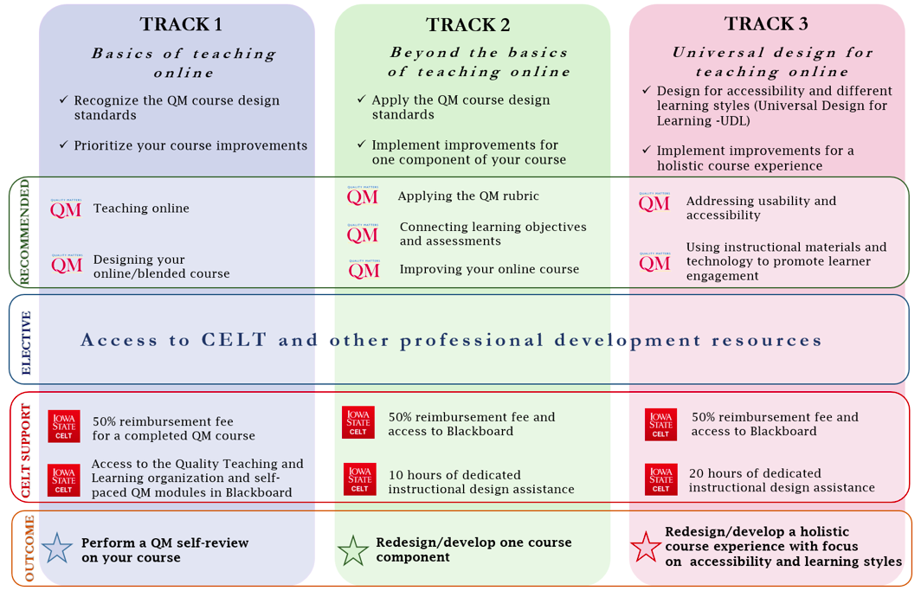
Quality Matters at Iowa State
CELT’s QM website: http://bit.ly/isuqmtracks
Notes:
CELT has developed a 3-track framework to help faculty to engage with the QM content. Faculty can either complete the tracks sequentially or complete any given track they deem appropriate based on their current teaching and learning needs. Each track include recommended and elective components and each has a deliverable that will result in concrete course design improvements.

Slide 22
Tip 5: Use Consistent Page Titles and Headings
Notes:
Tip 5: Use Consistent Page Titles and Headings. For users who rely on screen readers to interact with content, this step is crucial. Consistent and clear page titles help to orient visually impaired users who are unable to see the full layout of the site.

Slide 23
Example: Not formatted with headings
Lack of headings, section divisions inhibit scanning and reading
Notes:
Not formatted with headings
Lack of headings, section divisions inhibit scanning and reading

Slide 24
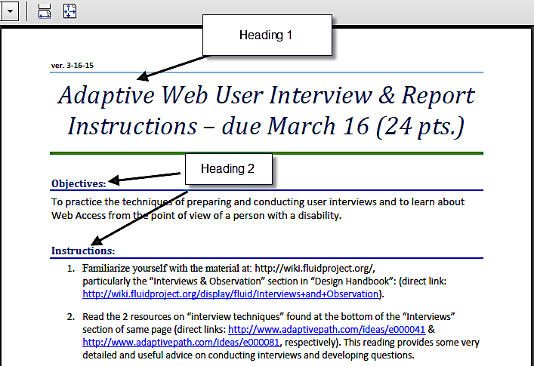
Examples: Properly formatted headings
Headings created properly in Word will transfer when exported to a PDF
Notes:
Properly formatted headings
Headings created properly in Word will transfer when exported to a PDF

Slide 25
Tip 6: Use Alt-Text, Captions, and/or Long Descriptions on All Images
Notes:
Every image must have alt-text, which can be set in Blackboard on the Insert Image pop-up window. This alt-text should be a concise description of the information conveyed by the image

Slide 26
Example: Alt Text for Image of Flowers (depends on context)
Story about tulips alt = “Yellow tulips blooming in the Spring”
Horticulture Class alt=“Tulipa gesneriana”
Decorative Image alt=“”
Notes:
When writing alt-text, consider the context of the image. What information is the image conveying to users? (Sometimes the answers is none, if the image is purely decorative, and this is acceptable! The alt-text can be left empty if it serves no informational purpose.)

Slide 27
Tip 7: Avoid Color Coding
Notes:
Ensure color is not the sole means of conveying important information

Slide 28
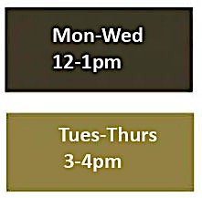
Example: Not accessible - Color Coding
Red Team and Green Team
Office Hours Provided Below
Notes:
What makes red team and green team example not accessible?

Slide 29
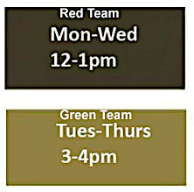
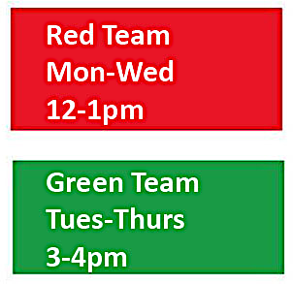
Example: Accessible Color Coding (Coding with descriptive words)
Red Team and Green Team
Office Hours Provided Below
Notes:
What makes this red team and green team example accessible?

Slide 30
Tip 8:
Sufficient Color Contrast
Notes:
Tip 8: Sufficient Color Contrast

Slide 31
Not accessible Insufficient Contrast
Accessible Adequate Contrast
Notes:
Example: Not accessible - Insufficient Contrast

Slide 32
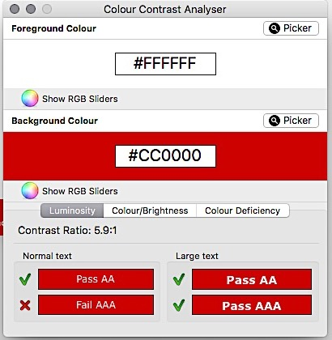
Hint: Use a Color Analyzer
Colour Contrast Analyser
available from The Paciello Group
Notes:
Use a color analyzer to see if the colors you are choosing for your website or PowerPoint will pass the contrast ratio.
This Colour Contrast Analyser application, available from the Paciello Group, demonstrates how this PowerPoint with the white on the red does pass with large text and would fail with normal text size. It does pass AA though – which is the minimum.

Slide 33
Tip 9: Use Descriptive & Unique Hyperlinks
Notes:
Tip 9: Use descriptive and unique hyperlinks. This is another strategy to help screen reader users. When providing a link, the link text should describe where it is going

Slide 34
Examples of Hyperlinks
Accessible
For information about incorporating course content in Blackboard, view CELT Incorporating Content into Your Course website
Not Accessible
For information about incorporating course content in Blackboard, click here
Not Accessible
For information about incorporating course content in Blackboard, http://www.celt.iastate.edu/teaching/blackboard-best-practices/incorporating-content-into-your-course
Notes:
Links should make sense when read out of context. Also, the distinguishing information of the link should be at the beginning of the link.
Try reading the full URL out loud and imagine having to listen to that every time an article contained a link!

Slide 35
Tip 10:
Create Accessible Multimedia
Notes:
Tip 10: Create Accessible Multimedia. One of the most well-known accessibility features is video captions. However, they are only one of many items needed to make multimedia—video, audio, and audio/video recordings—accessible.

Slide 36
Audio only
Text Transcript (of spoken word)
Video only
Video Description (of key visual elements)
Audio and Video
Closed Captions
Text Transcript
Video Description
Notes:
All video recordings must have captions that describe all relevant sound on screen, not just dialogue. If you have audio only - there should be a text transcript. If it is video only - include a video description of the key visual elements. If it is audio and video include closed captions, text transcript, and a video description.

Slide 37
Example: A Syllabus Overview
Walk through your syllabus in a video (Panopto)
Create a script for the video
Caption the video using the script (YouTube)
Post the video in your Blackboard course
Post syllabus as an accessible PDF
Notes:
An Example of making your course accessible may include a walk through syllabus. A syllabus is a necessary task at the beginning of every class. Students need to know where to find resources, how you’ll be evaluating them, and to hear you set the tone for the learning ahead. But often it takes up a good portion of the first class – valuable time that could be spent learning.
Instead of using class time, create a video that explains your syllabus. Your students can watch and re-watch it as many times as they need to. You can be certain that everyone hears and/or read the same message, even those who add the class later.

Slide 38
Next Steps
Notes:
Your Next Steps

Slide 39
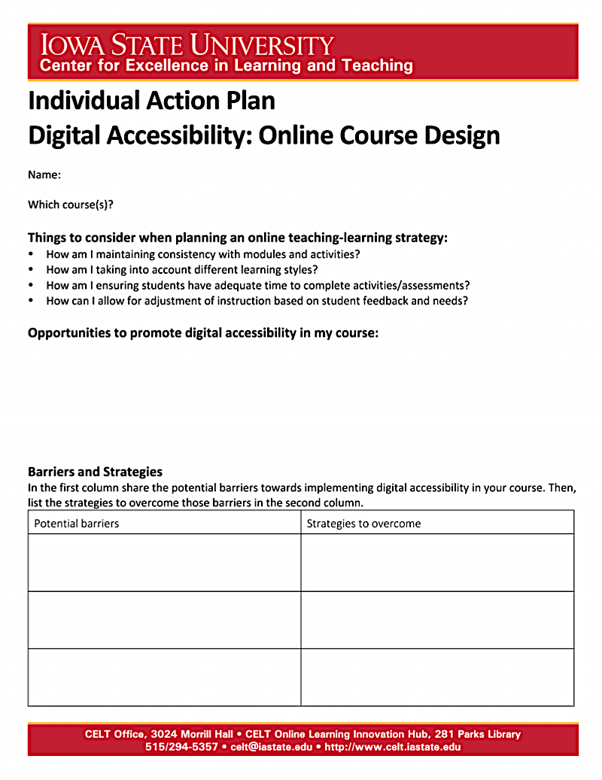
Scaffold for Success
CELT’s Individual Action Plan Digital Accessibility: Online Course Design
Notes:
Scaffold for Success
Use a resource such as CELT’s Individual Action Plan Digital Accessibility: Online Course Design shown here

Slide 40
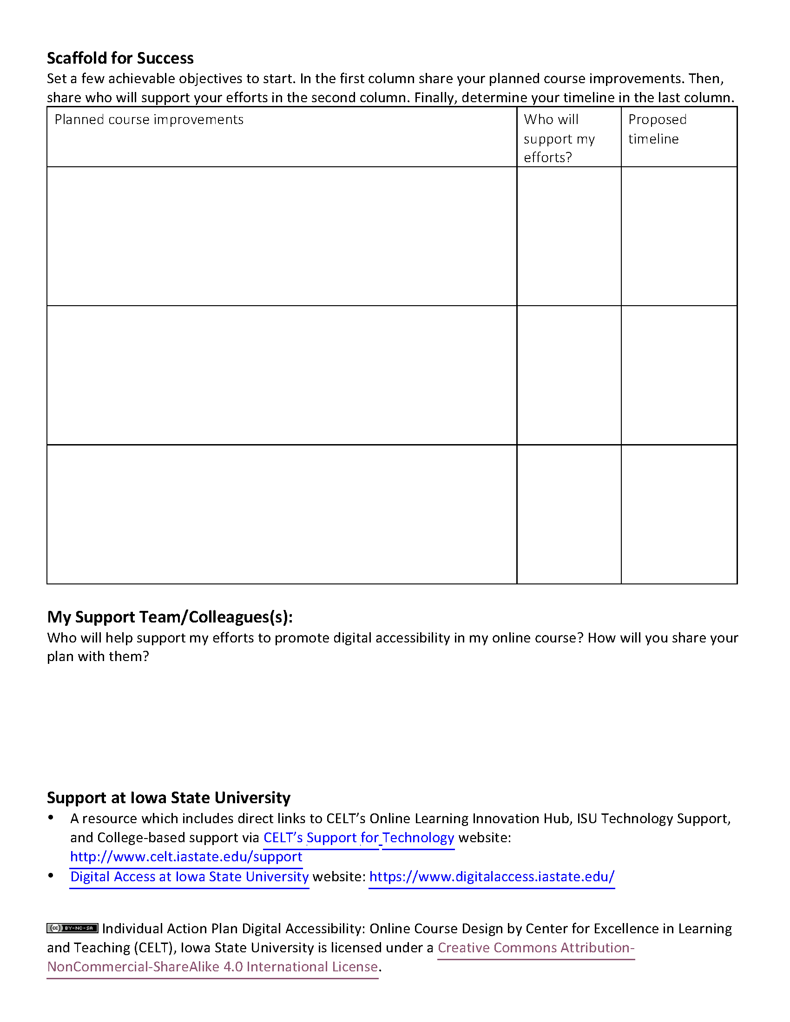
Scaffold for Success
Set a few achievable objectives to start.
Notes:
Set a few achievable objectives to start.

Slide 41
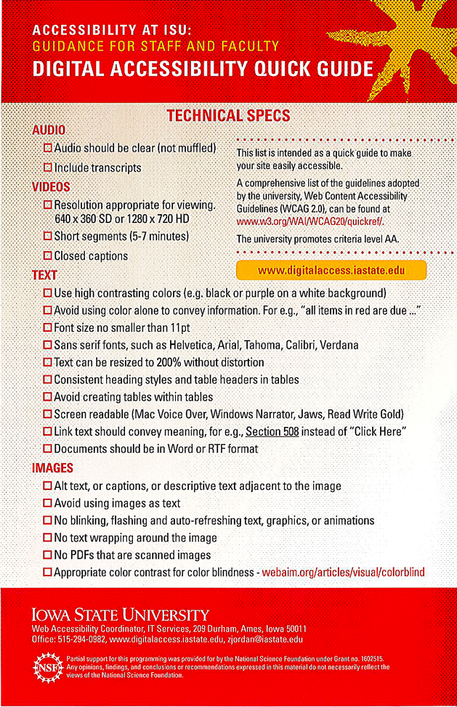
Digital Accessibility Quick Guide
Notes:
In your workshop folders you will find a Digital Accessibility Quick Guide that was developed by Engineering LAS Online and the Digital Accessibility Coordinator. This quick guide highlights many of the tips we just shared with you.

Slide 42
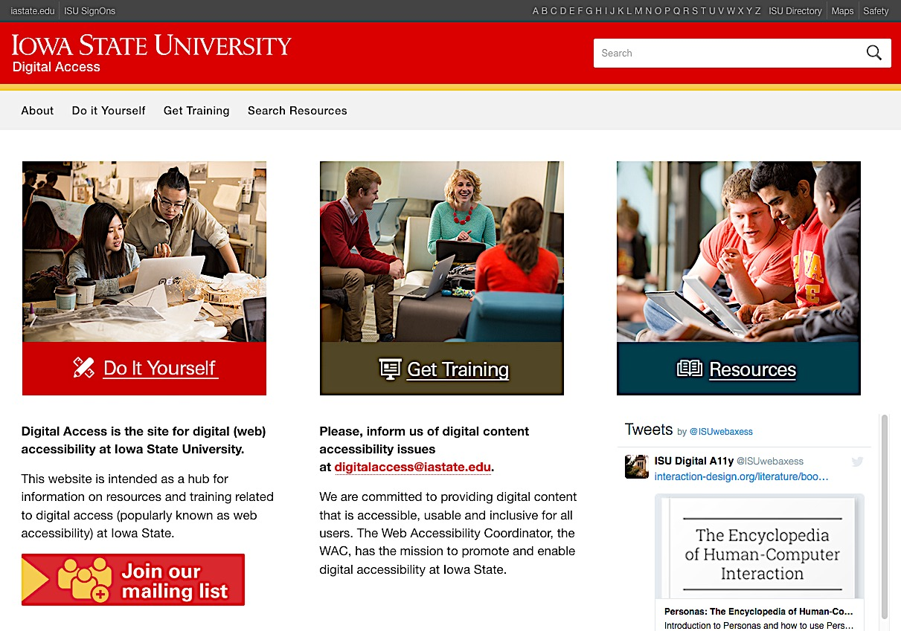
http://digitalaccess.iastate.edu/
ISU’s Digital Access website
Notes:
Furthermore, the Iowa State University Digital Access website hosts many resources for the University community to learn how-to incorporate and implement accessibility in web design, online courses and more. You may access the website http://digitalaccess.iastate.edu/

Slide 43
What Questions Do You Have?
Notes:
Conclusion: It’s not just about providing accommodations when requested. Waiting to react may be too late. Accessible courses and materials anticipate the possible needs of diverse learners and remove barriers or provide alternatives in advance.

Slide 44
This presentation adapted from:
Center for Excellence in Learning and Teaching (CELT). (n/d). Basic course design: Aligning course objectives with class assignments and your teaching approach. Iowa State University. Retrieved from http://www.celt.iastate.edu
Institute for Teaching and Learning Excellence. (n/d). Course structure examples. Oklahoma State University. Retrieved from http://itle.okstate.edu/fd/online_teaching/coursestructure.html
Kaplan, P., Howard, L., & Rainwater, B. (2016, September 21). BITS – Make news with accessibility awareness: Strategies to help faculty get started. Presented at the Higher Ed Blackboard Innovation Teaching Series (BITS). Retrieved from https://community.blackboard.com/

Slide 45
This presentation adapted from:
Office of Distance Education and eLearning. (n/d). UDL in Course Design. The Ohio State University. Retrieved from https://odee.osu.edu/udl-course-design
Sherer, C. (2015, June 15). 10 steps to make your course accessible with WCAG 2.0, part I. Blog post retrieved from http://dl.sps.northwestern.edu/blog/2015/06/1326/
Sylvia, J., & Bond, L. (2015, October 8). 10 tips for creating accessible online course content. Webinar presented for Online Learning Learning Consortium and 3Play Media, online. Retrieved from http://www.3playmedia.com/

Slide 46
Tools cited:
Colour Contrast Analyser (CCA) from Paciello Group website: https://www.paciellogroup.com/resources/contrastanalyser/
Iowa State University’s Digital Access website: http://digitalaccess.iastate.edu/
Quality Matters rubric standards from the QM Higher Education rubric, fifth edition from Quality Matters website: http://www.qualitymatters.org
Rice University’s Course Workload Estimator website: http://cte.rice.edu/workload
Universal Design on Campus website: http://udloncampus.cast.org/

Slide 47
Photo Credits with Links
Illinois Springfield. (2013). https://flic.kr/p/hwhsWk
Luc Legay. (2008). https://flic.kr/p/5uegbU
Francisco Osorio. (2013). https://flic.kr/p/fuGmBy
Michael Coglan. (2012). https://flic.kr/p/bAjAuZ
John Loo. (2013). https://flic.kr/p/egDAjA
Julie Lindsay. (2009). https://flic.kr/p/64xnkh
Office of University Marketing, Iowa State University. http://www.brandmarketing.iastate.edu/brand-elements/photography/

Slide 48
10 Tips for Creating Accessible Course Content by Center for Excellence in Learning and Teaching (CELT), Iowa State University is licensed under a Creative Commons Attribution-NonCommercial-ShareAlike 4.0 International License.

