Slide 1
Accessibility at ISU
The “What” and “Why” of Accessibility

Slide 2
Quick Links
What is a disability? Wendy Stevenson, Disability Coordinator
Universal Design Support for Buildings Dr. Arvid Osterberg, University Professor
Accessibility & the Legal Landscape in Higher Education Maureen De Armond, University Counsel
Benefits of Web Accessibility Dr. Zayira Jordan, Web Accessibility Coordinator

Slide 3
When you think of the word “disability,” what do you initially think?
Someone who
is anxious
is blind
does not read very well
has trouble concentrating
has been sexually assaulted
uses a wheelchair
is slow to respond

Slide 4
Numbers!
Fall 2010
Fall 2010 | TEA | Screening | Temp Health Condition | Reduced Course Load | Room Scheduling | Early Registration | Service Start | ISU Adm | SDR Enrolled | Total SDR
Eligible | 20 | 53 | 1 | 28 | 42 | 55 | 143 | 130 | 731 | 2978
In-Eligible (Red) | 16 | 47 | 4 | 0 | 0 | 0 | 96 | 71 | 139 | 1212
Total | 36 | 100 | 5 | 28 | 42 | 55 | 239 | 201 | 870 | 4190
Fall 2015
Fall 2015 | TEA | Housing/Dinning | Temp Health Condition | Reduced Course Load | Room Scheduling | Early Registration | Service Start | ISU Adm | SDR Enrolled | Total SDR
Eligible | 37 | 233 | 1 | 9 | 65 | 75 | 298 | 220 | 1114 | 4783
In-Eligible (Red) | 67 | 111 | 22 | 0 | 0 | 0 | 314 | 171 | 854 | 2823
Total | 104 | 344 | 23 | 9 | 65 | 75 | 612 | 391 | 1968 | 7606
From 870 students in Fall 2010 to 1968 students in 2015 – we are serving more than twice the number of students!

Slide 5
“Disability” Defined
To have a disability under the ADA, an individual must have an impairment that substantially limits a “major life activity”, which includes, but is not limited to, caring for oneself, performing manual tasks, seeing, hearing, eating, sleeping, walking, standing, sitting, reaching, lifting, bending, speaking, breathing, learning, reading, concentrating, thinking, communicating, interacting with others, and working.
Many disabilities (such as ADHD, Reading Disorders, and Social Anxiety) are not visible – 95%
Notes:
The Laws: Sections 504 and 508 of the Rehabilitation Act of 1973
American with Disabilities Act 1990: No otherwise qualified individual with disabilities in the United States shall solely by reason of his or her disability, be excluded from the participation in, be denied the benefits of, or be subjected to discrimination under any program or activity receiving Federal financial assistance.

Slide 6
Impact of Disability
Disability is unique for each person
Has different effects at different times
Limitations can be physical, biochemical, psychological, emotional, or environmental
Can lead to social isolation, development of low self-esteem, and difficulty in disclosure of the disability

Slide 7
Student Disability Resources
Must have documentation from a licensed qualified provider that must identifies the specific barrier created/resulting from the disability.
Works with ISU Departments/programs/campus partners to help provide “equal access” for students with documented disabilities.
Examples:
Accommodations with Registrar Office
Accommodations within classes
Facilities - Room Scheduling
Housing Accommodations
Assistance Animals on campus

Slide 8
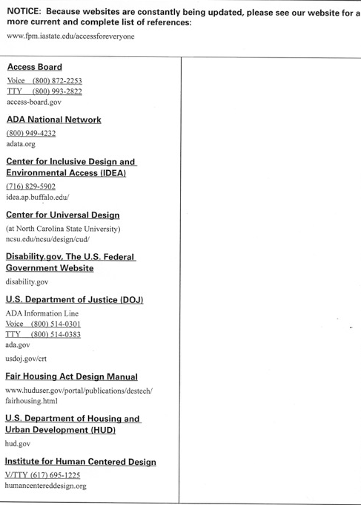

Slide 9
Accessibility & the Legal Landscape in Higher Education
Guess what all of these institutions have in common?

Slide 10
Accessibility & the Legal Landscape in Higher Education
Relevant Law
In Theory…
Rehabilitation Act of 1973
Americans with Disabilities Act
Iowa Civil Rights Act
In Reality…
There are no federal or state statutes or regulations governing web accessibility and online content
There are no published and binding web accessibility standards applicable to institutions of higher learning.

Slide 11
Accessibility & the Legal Landscape in Higher Education
Lessons Learned
Accessibility Audit - complete audit and develop a corrective action strategy
Policies and Procedures - have them, disseminate them, education about them…
Dedicated Staff - need staff with responsibility and authority to monitor accessibility and enforce policies

Slide 12
Accessibility & the Legal Landscape in Higher Education
Lessons Learned
University Website - adopt WCAG 2.0 level AA standards for university web content
Procurement - adopt accessible IT procurement standards; include in Requests for Proposals (RFPs); contracts
Misc Accessibility - Library; course/learning management systems; classroom devices(clickers); online services (banking; ATMs)

Slide 13
What is Digital Accessibility?
Notes:
Sign in sheet

Slide 14
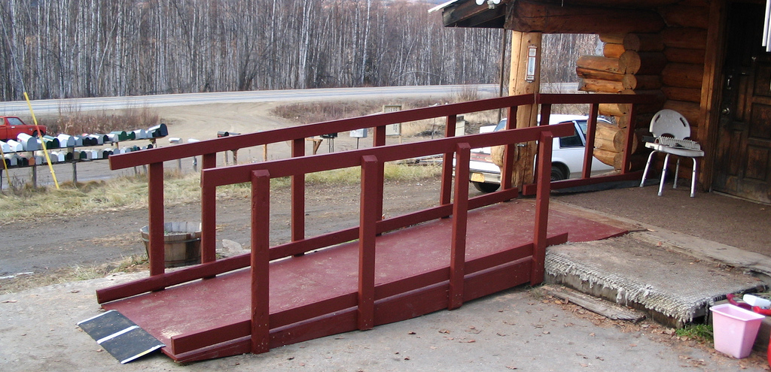
Notes:
What is the first thing that comes to mind when you hear the word accessibility?
Many associate accessibility with ramps and curb cuts which were, in fact, created as part of a movement toward universal design in the field of architecture.

Slide 15
Web accessibility means that people with disabilities can use the web.
Web accessibility also benefits people without disabilities.
World Wide Web Consortium (W3C)
Notes:
The world wide web consortium, the organization that sets web standards established by the creator of html, Tim Berners-Lee, established the Web Accessibility Initiative in 1997 to move toward universal accessibility. The idea was that the web was the technology that would democratize the world and allow everybody (no matter their background, age, level of ability, etc.) access to information and resources like no medium had ever before. The Web Accessibility Initiative (WAI) eventually developed a set of guidelines for web development that have already undergone one revision to respond to new technologies. But before we go over these more in depth… lets look at the reasons why we should care about all this…

Slide 16
Notes:
Most of you may be too young to remember the movie Blade Runner. If you watched it in Netflix any time after 2014 you would have for sure be able to use closed captioning. It was not always that way.
The ability for users to turn captions on in Netflix comes as the result of a settlement between Netflix and the National Association of the Deaf under the Americans with Disabilities Act. NAD members claimed that the internet was a place of public accommodation and close captioning was needed for equal access to the deaf and hard of hearing. They settled and as a result Netflix has captions now on all their movies.
There are at least two federal laws that deal with the rights of persons with disabilities, the Rehabilitation Act of 1973 and the Americans with Disabilities Act (ADA). At the state level, we have the Iowa Civil Rights Act that also deals with equality of rights for persons with disabilities. Tested in the courts, the settlements and decisions in at least 30 cases in higher education and others have established that online content should be provided in a way that offers equal access to persons with disabilities. What does that ultimately mean? We will go over the guidelines these settlements have provided in a few minutes… in the meantime, let’s look at the beneficial byproducts of accessibility.
When you adopt methods that address accessibility guidelines, it is highly probable that you will have an initial increase in time for development but eventually this benefits the development cycle. Among others, accessibility measures have been proven to reduce server load. But also… having your site appropriately coded following the guidelines developed by WAI results in increased readiness – new browsers and technologies that require semantic data may be more readily adopted with code that includes accessibility-related tags, the W3C also indicates your appropriate labeling and coding with accessibility in mind increases use and findability through SEO. Google likes the semantic data that code that follows guidelines provides. And as you see here, measures to address accessibility evidently increase good will and decrease the possibility of legal costs among others.
The W3C, in their case for accessibility makes a poignant remark and I quote: Google is the ultimate disabled user: It doesn’t see, it doesn’t hear, and it can’t use a mouse. Yet, along with the other search engines and the social web platforms powered by algorithms, it will increasingly function as your eyes and your ears in the search for relevant information. Making an institution’s web content accessible to all users will soon be a mere prerequisite to becoming findable in the overflowing stream of data, and ultimately visible on the web.
And finally, one another reason we want to address accessibility…

Slide 17
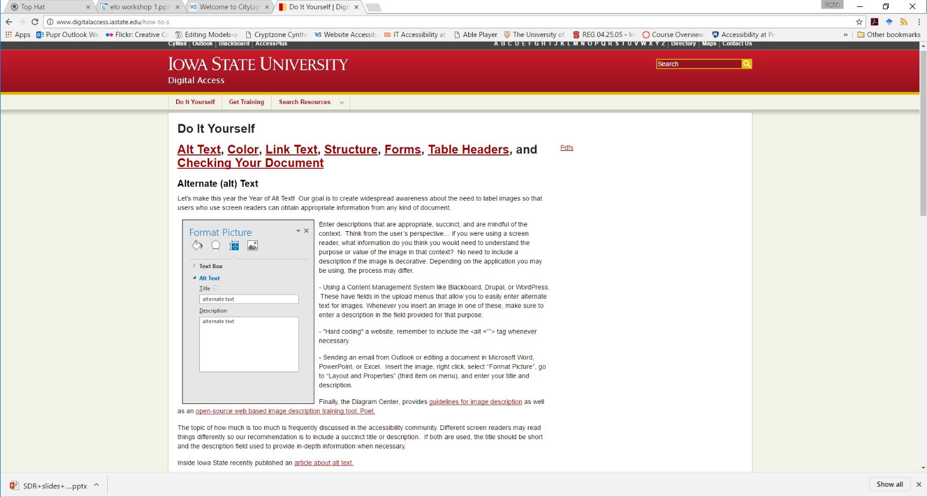
Before and After Demo

Slide 18
Where to Find Official Web Accessibility Standards?
The Web Content Accessibility Guidelines Version 2 or
WCAG 2.0 Level AA published by
the World Wide Web Consortium (W3C)
Notes:
The requirements that have become the de facto standard for addressing web (or digital) accessibility are the Web Content Accessibility Guidelines in their most recent version, number 2.0. If you search the web for resources, you will find an enormous amount of websites that deal with these requirements in a number of different ways. We propose that you look at…

Slide 19
More information about how to “Do It Yourself” at www.digitalaccess.iastate.edu

