Slide 1
Accessibility at ISU: Guidance for Staff & Faculty
Developing Digital Content for All
Zayira Jordan, Dena Fife, Ann Greazel, Pinar Arpaci, Jacob Petersen
October 5, 2016

Slide 2
Id Badges
Please identify yourself with:
Red if you are an Instructional Developer
Blue if you are a Web Developer
Badges are available on table at entrance.

Slide 3
Agenda
What
How
Hands-on

Slide 4
What is Digital Accessibility?
Notes:
Sign in sheet

Slide 5
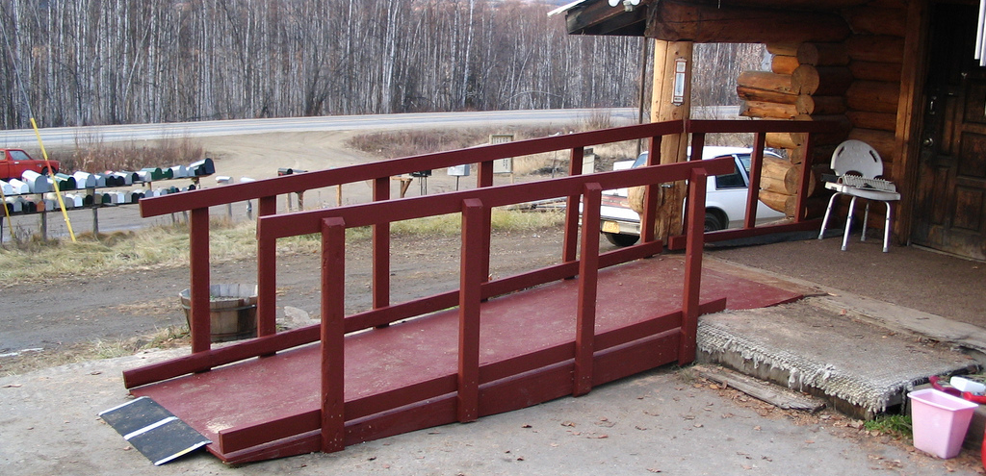
Notes:
What is the first thing that comes to mind when you hear the word accessibility?
Many associate accessibility with ramps and curb cuts which were, in fact, created as part of a movement toward universal design in the field of architecture.

Slide 6
Digital accessibility means that people with disabilities can use digital content.
It also benefits people without disabilities.
Adapted from the World Wide Web Consortium (W3C)
Notes:
The world wide web consortium, the organization that sets web standards established by the creator of html, Tim Berners-Lee, established the Web Accessibility Initiative in 1997 to move toward universal accessibility. The idea was that the web was the technology that would democratize the world and allow everybody (no matter their background, age, level of ability, etc.) access to information and resources like no medium had ever before. The Web Accessibility Initiative (WAI) eventually developed a set of guidelines for web development that have already undergone one revision to respond to new technologies. But before we go over these more in depth… lets look at the reasons why we should care about all this…

Slide 7
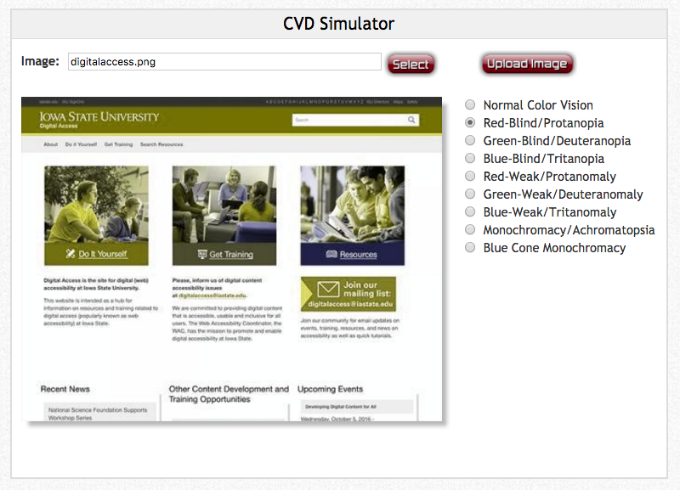
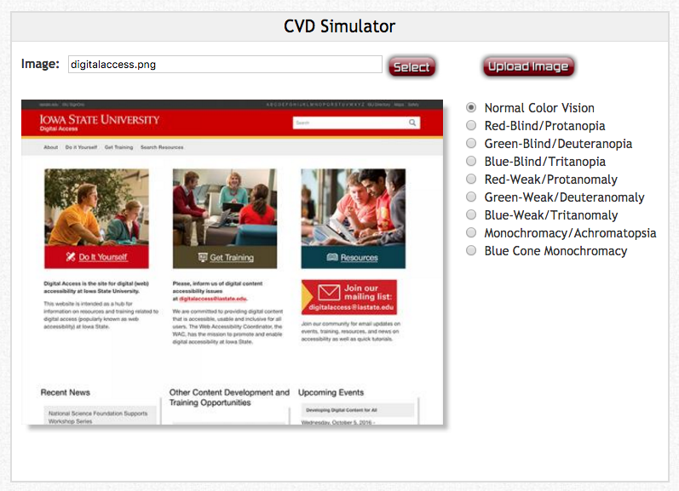
Color Blindness Simulator
http://www.color-blindness.com/coblis-color-blindness-simulator/

Slide 8
“How to do” Digital Accessibility?

Slide 9
Inaccessible
Images
<img src=”students.gif" alt=“ ”>

Slide 10
Accessible Images
<img src=”students.gif" alt=”Students in class">

Slide 11
Structure and Headings
Before
After

Slide 12
Math Images and Equations
Combine and utilize MathType with LaTeX, Blackboard, Moodle, TopHat, and Microsoft Office Products to create inclusive learning experiences.
MathType for Students : http://it.engineering.iastate.edu/software/students/
MathType for Faculty & Staff: http://it.engineering.iastate.edu/software/faculty-staff/

Slide 13
Inaccessible
Link Text

Slide 14
Accessible Link Text

Slide 15
Color
Color
Color
Color
Notes:
contraste y uso de color como indicativo de acción o significado

Slide 16
Captions
Notes:
Link
https://www.youtube.com/watch?v=MCm1Emtqo_Q

Slide 17
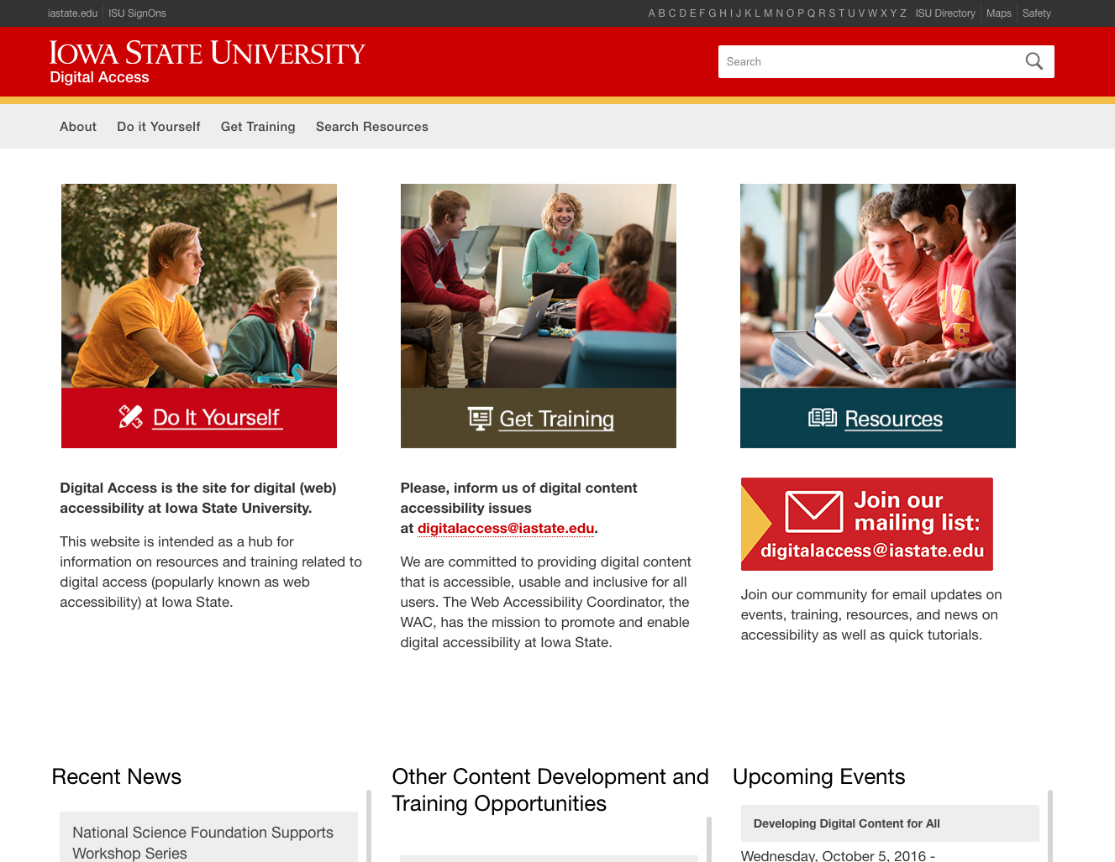
Consistent
Navigation
Navigational mechanisms that are repeated on multiple web pages within a set of Web pages occur in the same relative order each time they are repeated, unless a change is initiated by the user.
(WCAG 2.0, 3.2.3 Level AA)

Slide 18
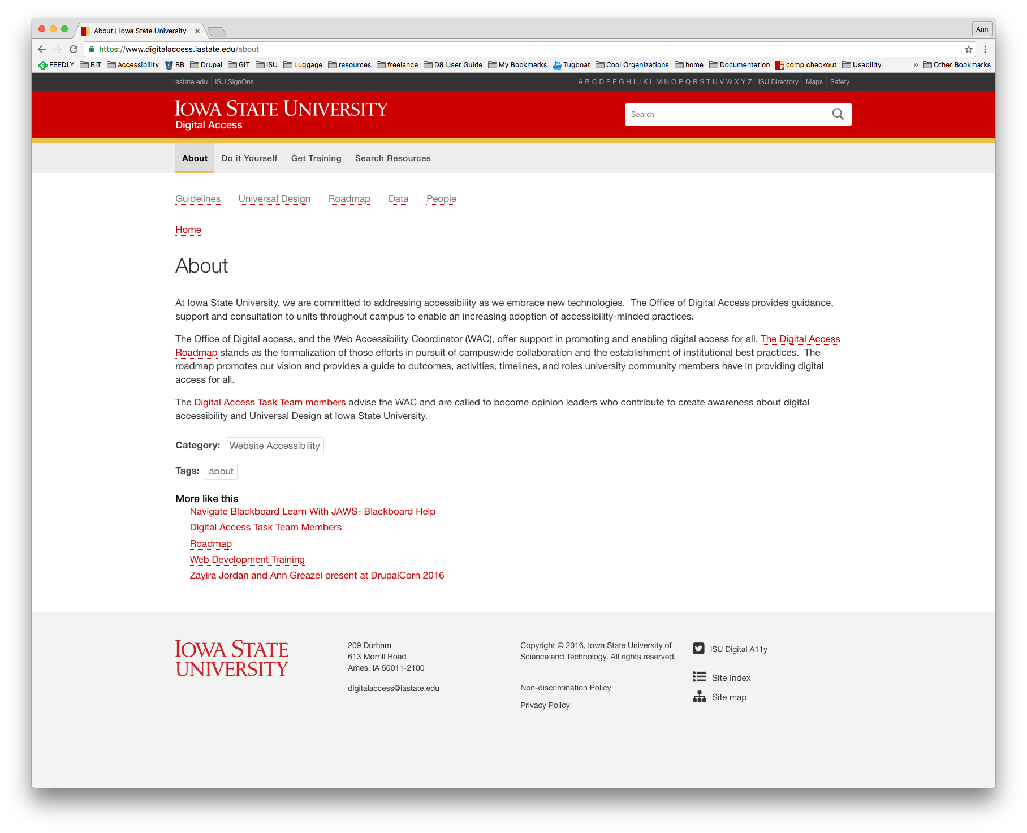
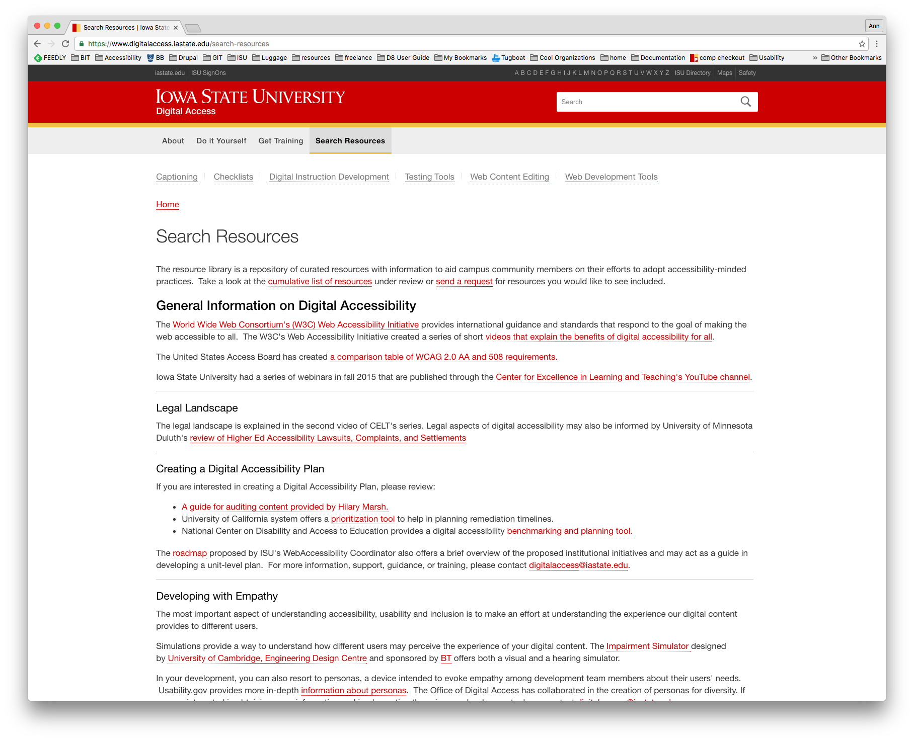
Examples provided by W3C
A Web site has a logo, a title, a search form and a navigation bar at the top of each page; these appear in the same relative order on each page where they are repeated.
For example, on a Web site of a company that sells products and offers training, when a user moves from the section on products to the section on training, the links to individual products are removed from the navigation list, while links to training offerings are added.

Slide 19
Testing Tools

Slide 20
Office Accessiblity Checker
Run a check and address findings with the help of the MS Accessibility checker.

Slide 21
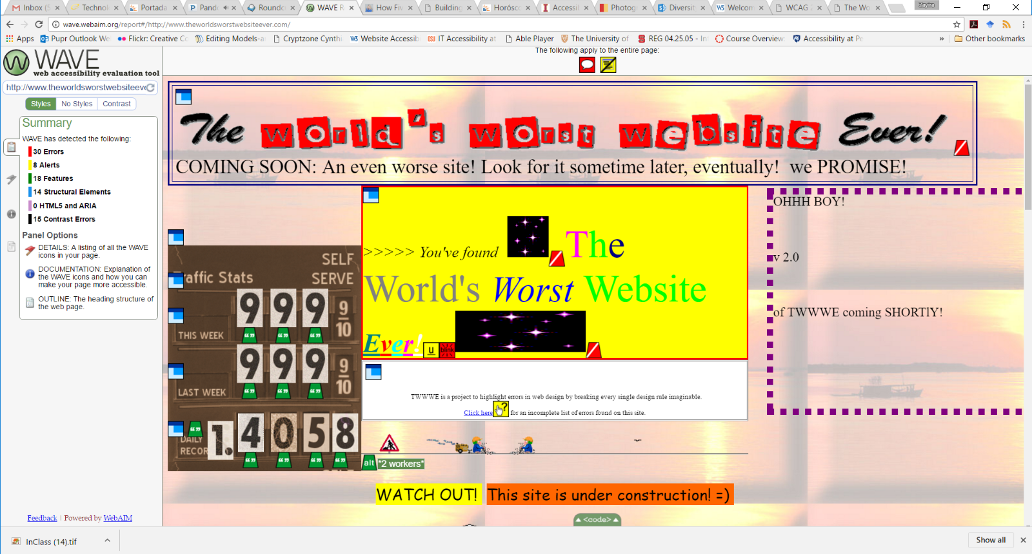
WAVE

Slide 22
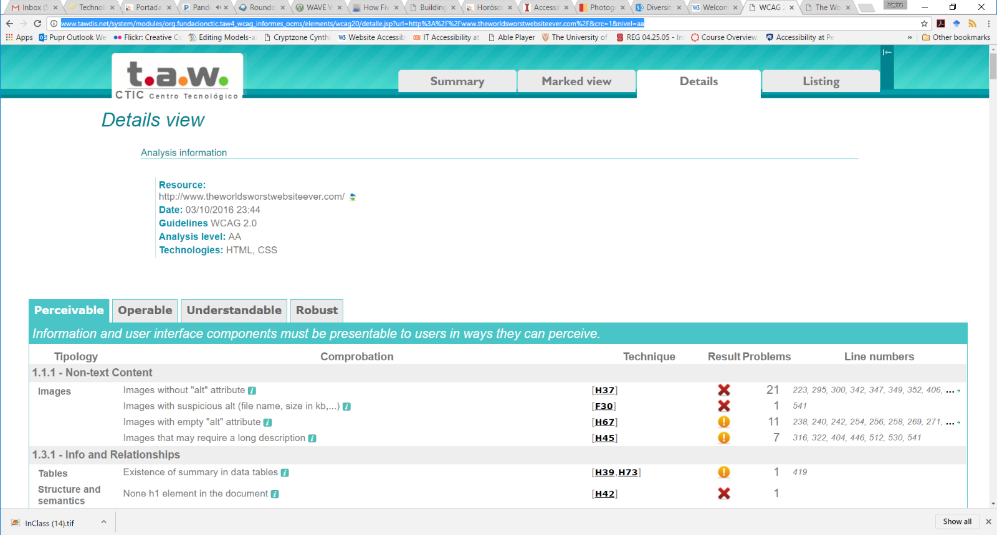
Tawdis

Slide 23
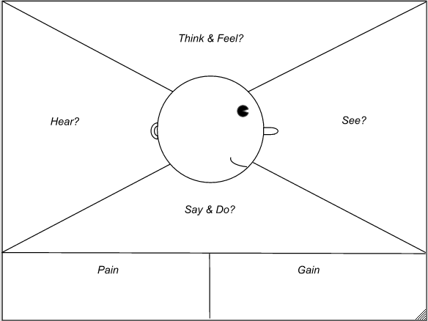
Empathy is queen.
You can resort to personas to increase the sensibility in your team about different needs.
You can help team members identify the user’s needs and wants by filling out an empathy map.
http://www.solutionsiq.com/images/Empathy-Map-No-Stickies.png

Slide 24
Let’s “play.”

Slide 25
How?
Gather in teams of 6 (more or less).
Identify a website or course to review (depending on your area of expertise).
Test (WAVE or Tawdis for web, course checklist –in folder-- for courses).
Discuss and agree on an answer to:
“If you could only do one thing to improve accessibility in this [site][course], what would it be?”
Choose a reporter.

Slide 26
More information about how to “Do It Yourself” at www.digitalaccess.iastate.edu

Slide 27
Other Resources
Instructional Development
Web Development
Center for Excellence in Learning and Teaching (CELT)
UDL on Campus
Open source book on disabilities and science and engineering education by Ruta Sevo
How Five Web Design Principles Boost Student Learning in an Online Course
How a course is evaluated for accessibility
WCAG 2.0 (Level AA)
WAI-ARIA
"Web Accessibility, Developing with Empathy,“ – a course by Udacity and Google

