Slide 1
Proposal
Steps to Writing and Revising your Proposal

Slide 2
Agenda
Discussion of Proposal Requirements for drafting, revising & editing your proposals
Analysis of Sample Proposal
Team work on methods , qualifications, benefits & conclusions sections

Slide 3
Title Page
Title
Subtitle ("A Proposal to [insert condensed objective]")
"Submitted to [insert name of funder]"
"Submitted by [include your organization]"
Date

Slide 4
Cover Letter (1 page)
In the 1st sentence, thank the funder, and include the project's objective.
Between the 1st and last sentences, include an executive summary.
In the last sentence, include a bulleted forecasting list of the major elements of the proposal.
Include a signature block.

Slide 5
Table of Contents
Use at least three levels, including the captions of visuals.
See Sample Proposal.

Slide 6
Background section—Story (3 pgs)
Story Component...
  Presents the needs assessment—a type of report of the research you did to gain insight to determine if the overriding problem is indeed a problem,
  Discusses the overriding problem as well as its causes and effects,
  Includes at least three visuals that help to tell the specifics of your story,
  Uses citations (which can be made up) as footnotes.

Slide 7
Background section—Story
Situation: This is our understanding of the problem.
Objectives: Given that problem, these are our objectives for addressing or solving it.
  Have no more than 2 objectives.
    Objective 1 is related to planning.
    Objective 2 is related to implementation.
  Keep them S-I-M-P-L-E

Slide 8
Background section—Objectives
  Specific—indicate precisely what you intend to change through your project.
  Immediate—indicate the time frame during which a current problem will be addressed.
  Measurable—indicate what you would accept as proof of project success.
  Practical—indicate how each objective is a real solution to a real problem.
  Logical—indicate how each objective systematically contributes to achieving your goals.
  Evaluable—indicate how much change has to occur for the project to be effective.

Slide 9
Background Section—Questions
Deliverables: The outcomes produced during the process of achieving the project’s objectives.
  Deliverables often produce benefits.
Phrase the deliverables as questions.
EXAMPLE:
  What kind of instruction do ELL students need?
  What resources do teachers need to better educate ELL students?
  How can we better incorporate ELL parents into the community?
  How do we help teachers, students and parents to better coordinate their efforts?

Slide 10
Background—Benefits
Benefits: Those good things that will accrue to stakeholders while the project’s objective(s) is in the process of being achieved (i.e., as deliverables are completed) or after the project objective(s) has been achieved.

Slide 11
Background—Closing
Specify the measurable and evaluable objective...
  ...the statement of which could require two or more sentences.
  To close the section include some briefly stated benefits.
EXAMPLE:
Our objective is to move 80% of Booneville Middle School ELL students from non-proficient status to proficient status on the Iowa Test of Basic Skills by the end of the 2009-2010 school year, as shown on the next page in figure 4.

Slide 12
Methods Sections (3 pgs not including Gantt Chart)
Introduction to this section discusses lessons learned from projects similar to this one.
Similar Projects: Projects, conducted by others not in your organization, that your own project will build upon and, ideally, extend.
Transition to the Gantt Chart, which provides a forecast of the tasks and timeline.
Present the major tasks necessary for achieving the objective.

Slide 13
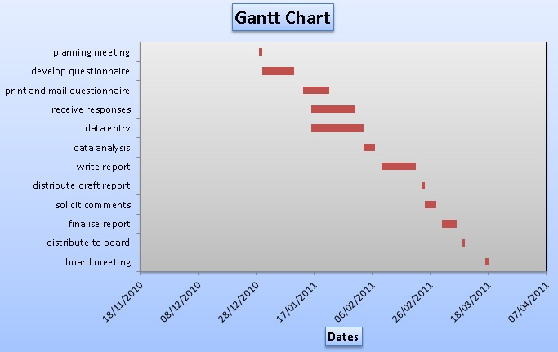
Sample Gantt Chart

Slide 14
Methods section
As the last three tasks, discuss the evaluation, continuation and replication plans.
Construct the section's closing by indicating, in one paragraph, the benefits of your methodology.

Slide 15
Qualifications Section (2 pp.)
End the introduction of this section with a bulleted forecasting list of the major claims, expressed as complete sentences.
In the body use a claim in each subhead, and under each subhead, demonstrate how and/or why the claim is true.
For the body of this section, discuss each of those claims in a subsection, arguing why that claim is true.
Make certain that one of the claims focuses on the project’s team members, and that the related subsection discusses relevant information for each team member.

Slide 16
Benefits Section (1p.)
If necessary, end the introduction with a bulleted forecasting list of the major claims, expressed as complete sentences
In the body use a claim in each subhead, and under each subhead, demonstrate how and/or why the claim is true
Include the beneficiary
Repeat each benefit-claim as a subhead in the body of the section

Slide 17
Conclusion (paragraphs)
Separate the conclusion from the benefits section with several spaced asterisks or some other visual device
Summarize the major persuasive elements of the proposal

Slide 18
Visuals (at least 3)
Reference each visual in the text.
Include in each visual a caption-claim that the entire visual has been designed to "prove“.
Design all text in a visual, including its caption, to be one or more point sizes smaller than the normal text.

Slide 19
Document Design
Include key information (including p.#s) in the header and/or footer
Use "block" format--i.e., don't indent ¶s
Include more space before a heading than after it
For your "normal" text, use a serif font like Times New Roman
For the text in your visuals, prefer a non-serif font (e.g., Verdana, Helvetica, Gil sans)
Differentiate your headings.
Create a professionally designed document.

Slide 20
Sentence-level Requirements
Use sentences that are grammatically and mechanically error-free.
See Chapter 20, TCT for additional sentence-level requirements.
Leave enough time for revision and editing!

Slide 21
Team Activity
Open the Sample Proposal Document on Arisoph.
Using this PPT, discuss each of the different sections of the Proposal.
  Explain whether or not the sample meets the requirements of each of the different sections as explained in this PPT?
    Use quotations from the sample to substantiate your claims.
    What does it do well? What could be improved?
  Appoint a scribe (to record ideas) and a spokesperson (to speak for the group).
Be prepared to share your findings with the class.

Slide 22
Team Work
By the end of today, your team should be finished with the background, methodology and qualifications sections.
The first draft of the Proposal (proper) should be finished by Thursday.
Remember to keep track of team meetings (quantity and mode of communication).
  Create a chart displaying this information & include it as an appendix to the proposal.

Slide 23
Assignments
Next time...
  Read Ch 20, TCT
  Durham lab will be devoted to formatting title page, cover letter, table of contents, revising & editing the Proposal
  And, creating PPT presentation to share your proposal with the class
  Proposal presentations will be Thursday, October 17.

