Slide 1


Slide 2
Chapter 6
Technical Descriptions, Specifications & Definitions

Slide 3
Chapter Outline
Planning and Researching
  Considering Audience, Purpose & Tone
Partitioning the Subject
Organizing and Drafting
  Help: Using Digital Photography in Descriptions
Using Style and Design
  Microgenre: Technical Definitions

Slide 4
Review of Genres and the Technical Writing Process
Genres
  Relatively stable patterns that reflect the activities and practices of the workplace
  Shape a document’s content, organization, style, design, and medium
  Help you anticipate the needs of your readers and their situations
Notes:
Genre Example – Technical specifications vs. analytical reports
different kinds of information
different workplace situations
different organizational patterns
different style and design
Genres do more than help you organize your ideas
They help you interpret complex work situations
Genres reflect the activities and practices of scientific and technical workplaces.
Each genre should be adapted to fit the readers and situations.

Slide 5
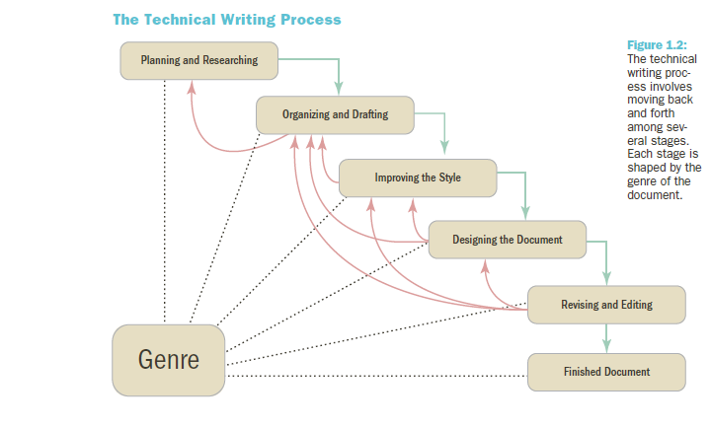
Overview

Slide 6
Developing a Workplace Writing Process (1)
Stage 1: Planning and Researching
  Define the rhetorical situation
  State your purpose
  Research your subject
Stage 2: Organizing and drafting the content
Stage 3: Improving the style
  Plain style and persuasive style
Notes:
Planning and Researching involves three activities:
Define the rhetorical situation (The five W and How questions give you a sense of your rhetorical situation.)
Four elements of the rhetorical situation:
Subject – what is document about? What is the scope of the project?
Purpose – what is the document trying to achieve? Why do the readers need it? What do they need to know?
Readers – who are the readers? What are their needs and interests? What are they looking for?
Context of Use – where and when will the document be used? What constraints are there?
2. State your purpose – what you want to do and what you want your document to achieve
Purpose statement will help guide decisions about document, focus writing.
Try to express exactly what you want your document to achieve using action verbs.
Research your subject – gather information from a variety of sources
Information management is key

Slide 7
Developing a Workplace Writing Process (2)
Stage 4: Designing the Document
Stage 5: Revising and Editing
  Level 1: Revising
  Level 2: Substantive editing
  Level 3: Copyediting
  Level 4: Proofreading
Notes:
Organizing and drafting
Organizing the content – use common genres
Drafting the content – include facts, data, reasoning, and examples
Improving the style
Plain style – stresses clarity and accuracy
Persuasive style – aims to motivate readers by appealing to their values and emotions
Similes and analogies add a visual quality to work
Metaphors change readers perspective
Changes in tone and pace add energy and color
Most workplace texts are written in plain style.
Goal should always be clear and concrete writing.

Slide 8
Planning and Researching
Technical Description Genre
    Detailed Explanation of Objects, Places, or Processes
    Start by Considering the Five-W and How Questions
      Who might need this description
      Why is this description needed
      What details and facts should this description include?
      Where will this description be used?
      When will this description be used?
      How will this description be used?
Notes:
There are several types of technical descriptions, written for various purposes in the technical workplace.
Technical description
Patents
Specifications (specs)
Field notes
Observations
Ask the Five-W and How Questions
Who might need this description?
Primary, secondary, tertiary, and gatekeeper
Why is this description needed?
What details and facts should the description include?
Where will the description be used?
How will this description be used?
Define the subject – what it is, what its features are, boundaries.
Define the purpose – what should your description achieve?
Define the readers – primary, secondary, tertiary, and gatekeeper readers.
Define the context of use – what economic, ethical, and political factors will influence your readers?

Slide 9
Organizational Model of Technical Descriptions
Title
Introduction
Major Part
Major Part
Conclusion
Definition of subject
Main Point
Importance of Subject
Overall Description
List of Major Parts
Definition and Purpose of Part
Minor Part
Minor Part
Etc (repeated as needed)
Definition and Purpose of Part
Minor Part
Minor Part
Etc (repeated as needed)
Importance of Subject
Future of Subject
One Operating Cycle
Purpose Statement
Specific
Precise

Slide 10
    Subject, Purpose, Readers, & Context
Subject: What exactly is your subject?
  What are its major features?
  What are its boundaries
Purpose: What should your technical description achieve?
  Do the readers want exact detail?
  Do they want familiarity with the subject?
  Use these verbs to help clarify purpose...
    Describe, illustrate, show, depict, characterize, represent, clarify, reveal, explain, portray

Slide 11
Planning and Researching (cont.)
When Researching...
  Do background research
  Use your senses
  Take measurements
  Describe motion and change
  Describe the context
  Create or locate graphics
  Ask subject matter experts
Notes:
Do background research
Know as much as possible about your subject before making direct observations. Use the internet and print sources.
Use your senses
Take notes with sensory details including colors and textures.
Take measurements
Take exact measurement for height, width, depth, weight, etc.
Describe motion and change
Pay attention to subject’s movements and patterns, changes or transformations.
Describe the context
Take notes about surroundings of subject and subject’s interaction with things and people.
Create or locate graphics
Collect graphics that illustrate subject. Draw or take pictures of subject.
Ask subject matter experts
SMEs can answer questions and fill in gaps in understanding.

Slide 12
Partitioning the Subject
Partition
By features
By functions
By stages of a process
Logical (Concept) Mapping Can Help Break Down (Partition) Your Subject
See next slide.
Notes:
Partition by features
Describe parts or features of subject.
Partition by functions
Note how your subject’s different parts function.
Partition by stages of a process
Partition chronologically showing how your subject is assembled or how it works.

Slide 13
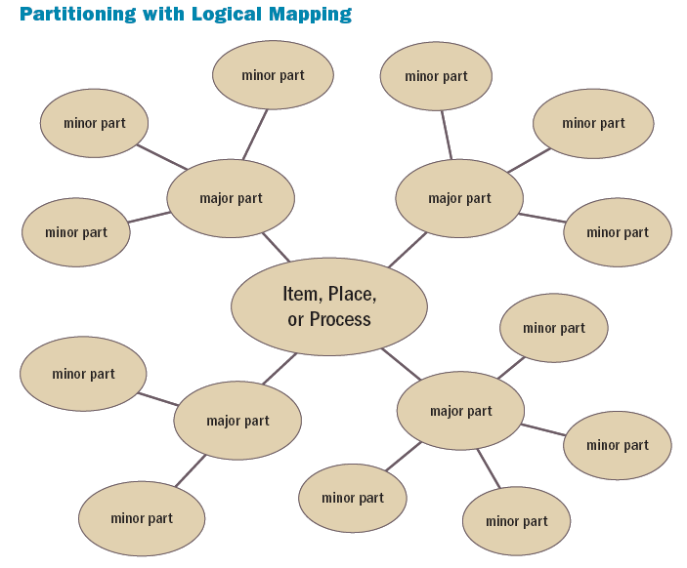

Slide 14
Organizing and Drafting
Use a Specific and Precise Title
Include an Introduction with an Overall Description
Include a Description by Features, Functions, or Stages
Include a Description by Senses, Similes, Analogies, and Metaphors
Conclude
Notes:
Use a specific and precise title – title should clearly identify the purpose of the document.
Include an introduction with an overall description – set a framework or context by including some or all of the following features:
Definition of subject
Purpose statement
Main point
Importance of subject
Overall description of subject
List of major features, functions, or stages
Include a description by features, functions, or stages – address each major part, identify and describe minor parts.
Include a description by senses (five senses,) similes (“A is like B”,) analogies (“A is to B as C is to D”,) and metaphors (saying “A is B”)
Conclusion should be short and concise

Slide 15
Help: Using Digital Photography in Descriptions
Insert Visuals into Your Descriptions
Consider
Resolution
ISO sensitivity
Shutter speed
Cropping
Notes:
Resolution
Digital cameras allow you to set resolution. Smaller is better for quick downloads. Larger is better for printing. .jpeg or .png format are usually best for online. .tiff files are best for printing.
ISO sensitivity
ISO is the amount of light the camera picks up.
Shutter speed
Shutter speed determines how much light is allowed into the camera when you push the button.
Cropping
Cropping removes things you don’t want from a photo.

Slide 16
Using Style and Design
Style Should Be Simple and Straightforward
Design Should Clarify and Support the Text
Plain, simple style
Page layout that fits
Graphics that illustrate
Notes:
Plain, simple style
Use simple words and limit jargon
Focus on need-to-know details
Keep sentences short
Remove subjective qualifiers
Use senses to add detail
Page layout that fits
Use two or three-column format to leave room for images.
List any minor parts in bulleted lists.
Add a sidebar that draws attention to an important part or feature.
Use headings to clarify organization.
Put measurements in a table.
Graphics that illustrate – pictures, illustrations, and diagrams help readers visualize your subject and its parts.
Use a title and figure number with each graphic.
Refer to the graphic by number in the written text.
Include captions that explain what the graphic shows.
Label specific features in the graphic.
Place the graphic on the page where it is referenced or soon afterward.

Slide 17

Practice Writing a Description
Open a shared Google Doc w/ your team & me
Follow the steps in this PPT & TCT, ch 6 to create a product description of this item.
Be sure to include a drawing (freehand or computer) of the item.
Label its parts
Write description

Slide 18
Free Software
For Mac
  http://www.maclife.com/article/features/10_free_open_source_alternatives_adobe_creative_suite
For PC
  http://lifehacker.com/5976725/build-your-own-adobe-creative-suite-with-free-and-cheap-software

Slide 19
Microgenre: Technical Definitions
A Basic Definition (Sentence Definition)
Has Three Parts
Term being defined
Category in which the term belongs
The distinguishing features that differentiate it from its category
An Extended Definition Starts with a Sentence Definition and Then Expands on It
Notes:
Extended definition expands on a sentence definition in the following ways:
Word history and etymology
Examples
Negation (explain what the subject is not)
Division into parts
Similarities and differences
Analogy
Graphics

Slide 20
Expanded Definitions
Starts with sentence definition
Uses other ways of defining such as...
  Word history & etymology
  Examples
  Negation
  Division into parts
  Similarities & differences
  Analogy
  Graphics

