Slide 1
Technical Descriptions
Considering Audience & the Rhetorical Situation

Slide 2
What is a Rhetorical Situation?
  Rhetoric: Using language effectively to persuade, inform, educate, or entertain
  Rhetorical Situation: The circumstances in which you communicate.

Slide 3
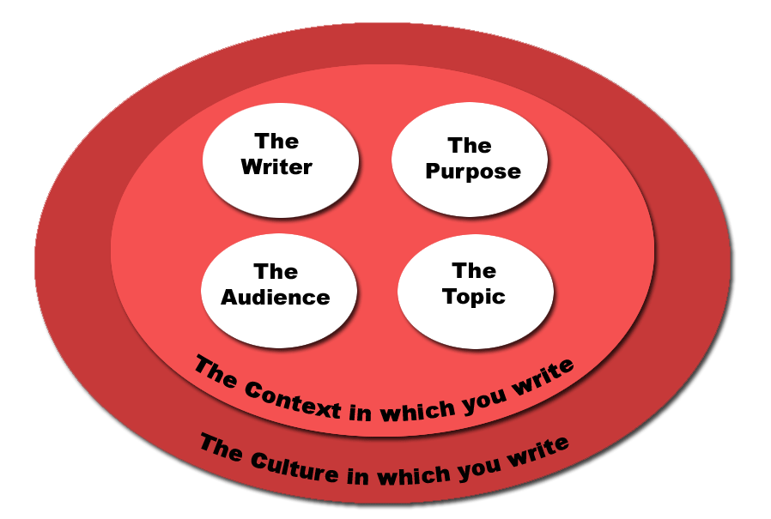
The Rhetorical Situation
Notes:
Key Concept: What is the “rhetorical situation”? It is the position of your writing in relation to various elements that affect the content and comprehension of your words--the identity of the writer, the purpose, the audience, the topic, and the context for writing. Each of these factors plays an important role in the writing process, and it is important to think about these in the planning stages of any writing project.
Rationale: While students may be aware of each of these factors, it is important to consider the relationship of these factors in the production of a written document. The following slides will serve as a guide to discussing each of these important factors and their relationship to each other.

Slide 4

The Writer
Your culture, personal characteristics and interests affect what you write about and how you write it.
Notes:
Key Concept: Students tend to see writing as an egocentric activity--the expression of personal opinions, experiences, and emotions. Certainly, the writer has the most important role in the rhetorical situation because the writer is the one who makes decisions about what goes into his or her paper. However, there are many things about an individual that affect the way he or she writes about different subjects. Personal characteristics and interests play a major role in the writer’s choice of topics, position in an argument, and the style selected for communicating with an audience.

Slide 5
Factors which can affect your writing include:
Your age
Your experiences
Your gender
Your location
Your political beliefs
Your parents and peers
Your education
Notes:
Rationale: This slide offers a sampling of eight different characteristics about a writer that can affect his or her approach to writing (this slide will require a mouse click for each factor). There are, of course, many more factors, and the facilitator may choose to have the class brainstorm a variety of personal factors that affect writing situations.
Examples: To illustrate how these factors play a role in writing, the facilitator may choose to discuss some of the following examples:
Age--Age can play a huge role in how a writer thinks about a topic. Consider how a seventy-year-old would write about the subject of retirement benefits as opposed to an eighteen-year-old.
Experiences--How would someone who fought in the Vietnam War write about guerilla warfare differently than someone who has never fought in a war?
Gender--How might a woman write about the subject of abortion differently than a man might choose to write about it?
Activity: The facilitator may also choose to have the class participate and offer examples about the role of personal factors in hypothetical writing situations—an editorial letter about gun control, an article about home schooling, or an argument about drunk driving penalties.
Click mouse for each item in the list.

Slide 6
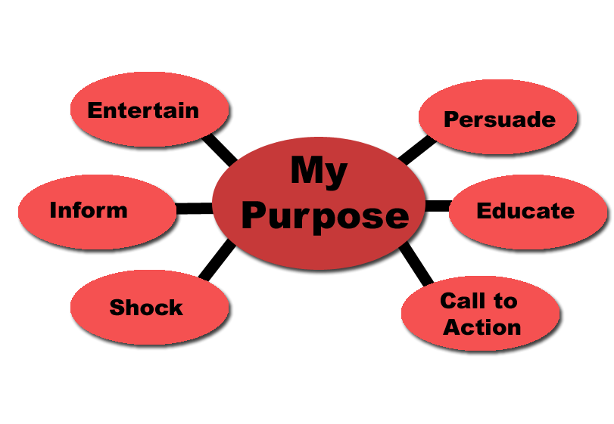
Purpose: Your Reason For Writing
Notes:
Key Concept: People compose written documents for many reasons or purposes. Writing purposes can be best expressed in an infinitive statement: to + verb. The first click on this slide will show the infinitive statement. Additional clicks will provide a sample list of six different purposes for writing, but, of course, many more purposes for writing exist.
Activity: The facilitator may choose to show the infinitive statement, and then have the class brainstorm different reasons for writing. Participants might also be asked to give an example of their selected purpose at work.
Examples:
to educate--a composition textbook, a medical pamphlet about neonatal care, a magazine article about the differences between computer virus detectors
to call to action--a letter to your senator about nuclear waste, a letter to a newspaper editor about abandoned pets, an advertisement for a new credit card
to entertain--a magazine article about the new Tom Cruise movie, a comic strip, a web site devoted to presidential gaffes
Key Concept: The facilitator may point out that it is important to consider the purpose of the assignment itself. For example, a student who is given the assignment to write a persuasive paper and only writes an informative paper will not be fulfilling the requirements of the project.

Slide 7
Genre
Category or type of writing
Genres hinge upon purpose and the needs/expectations of the projected audience.
Examples: fiction, autobiographical story, news article, review, letter to the editor/editorial, rhetorical analysis, criticism, persuasive essay
Notes:
Key Concept: Genre is also an important element when considering the purpose of a writing assignment. A genre is a category of writing; the purpose of writing is shaped by the category of writing and its projected audience. Stephen King, an author of horror stories, writes to shock and entertain his audience. Molly Ivins, a political writer, tries to persuade her readers through her editorials to accept her opinions and enact change.
Activity: The slide presents several examples of different writing genres. To promote discussion, the facilitator may ask participants to brainstorm additional examples. You can also relate genre to movie genres and talk/brainstorm about it from that angle.

Slide 8
Audience: To Whom are you Writing?
Many of the same factors which affect the writer also affect the audience
  Age
  Social class
  Education
  Past experience
  Culture/subculture
  Expectations
Notes:
Key Concept: The audience, the group to whom one writes, is affected by many of the same factors that influence the writer. Writers need to use appropriate word choices and tone to appeal to their audiences. Consideration of the factors that define a particular audience will aid in making writing persuasive and effective.
Activity: The facilitator may ask participants to consider how a writer’s conception of his or her audience changes in each of the following examples:
How might a writer in favor of gun control write towards members of the National Rifle Association? A gun control advocate group? An undecided voter?
How might a historian explain the Clinton impeachment trial in a second grade history textbook? A ninth grade textbook? A college textbook?
How might you write a letter to your parents about the last party you attended? To your best friend from high school? To your grandmother?
Key Concept: Students sometimes tend to take the concept of audience very literally--”I’m writing this paper for my instructor.” The facilitator may here choose to talk about a general writing audience: twenty to forty-five years old, men and women, college educated, generally aware of world events.

Slide 9
Topic: What you will write about
May be broadened or narrowed depending on the length of your writing and your interest
Topics should be appropriate to the rhetorical situation you are in
Notes:
Key Concept: Topic is usually the first thing students think of when they are given a writing assignment. When coming up with a topic, it is important to consider the parameters of the writing assignment, the projected length of the project, and the complexity of the issue being discussed. Narrowing a topic is an important process that should not be overlooked; making a topic more specific and focused can help the writer to build a more controlled, comprehensive, and compelling argument.
Examples: The American welfare crisis is not a topic that could be adequately covered in a three-page paper; this is a topic that might be more appropriately covered in a book-length argument. Conversely, the need for a new university bike rack is not a topic that could be covered well in a twenty-page assignment. Sometimes topics, such as the need for bike racks, need to be broadened to fit the requirements of the assignment.

Slide 10
Context
The “situation” which generates the need for writing
Affected by the
  Time period or timing
  Location
  Current events
  Cultural significance
Notes:
Key Concept: Context is defined as the “situation” that generates the need for writing. The topic, purpose, writer, and writing audiences are all affected by current events, location, social customs, and cultural changes. The facilitator may note that the assignment and intended academic audience also impact the context of an assignment. It is important to consider the goals of the assignment in developing a focus.
Examples: For example, 1999 newspaper editorials about school violence were motivated by the Littleton school shootings. Articles about Kosovar refugees are written with different purposes in the United States than those published in Belgrade newspapers. Computer technology is written about much differently today than it was in the 1960s. Keeping attuned to the social, political, and cultural climate of your audience can help writers to produce current, convincing writing.
Activity: The facilitator may choose to look at recent newspaper headlines and invite class participants to consider the context for their production.

Slide 11

Rhetorical Situation
Writer
Purpose
Audience
Topic
Context
Culture
Notes:
Rationale: This slide offers a review of the five interconnected components of the rhetorical situation. These elements are especially important when engaging in different categories, or genres, or writing.

Slide 12
What this means…
You need to be aware that a rhetorical situation exists every time you write.
You need to adapt your writing depending on your purpose and your audience.
Notes:
Rationale: This final slide reemphasizes the importance of the rhetorical situation. At this point, the facilitator may choose to reemphasize components that might be especially important for the development of a given class assignment.
Click mouse for each paragraph.

Slide 13
Review of Genres and the Technical Writing Process
Genres
  Relatively stable patterns that reflect the activities and practices of the workplace
  Shape a document’s content, organization, style, design, and medium
  Help you anticipate the needs of your readers and their situations
Notes:
Genre Example – Technical specifications vs. analytical reports
different kinds of information
different workplace situations
different organizational patterns
different style and design
Genres do more than help you organize your ideas
They help you interpret complex work situations
Genres reflect the activities and practices of scientific and technical workplaces.
Each genre should be adapted to fit the readers and situations.

Slide 14
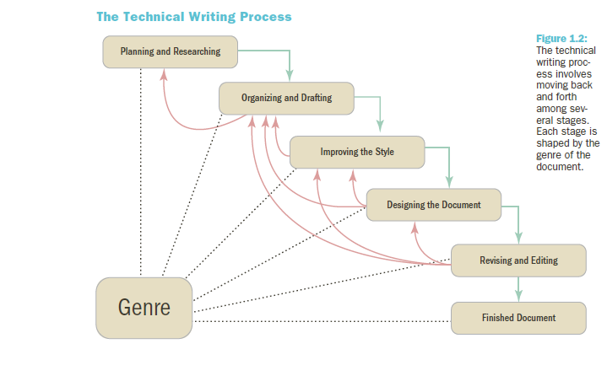
Overview

Slide 15
Developing a Workplace Writing Process (1)
Stage 1: Planning and Researching
  Define the rhetorical situation
  State your purpose
  Research your subject
Stage 2: Organizing and drafting the content
Stage 3: Improving the style
  Plain style and persuasive style
Notes:
Planning and Researching involves three activities:
Define the rhetorical situation (The five W and How questions give you a sense of your rhetorical situation.)
Four elements of the rhetorical situation:
Subject – what is document about? What is the scope of the project?
Purpose – what is the document trying to achieve? Why do the readers need it? What do they need to know?
Readers – who are the readers? What are their needs and interests? What are they looking for?
Context of Use – where and when will the document be used? What constraints are there?
2. State your purpose – what you want to do and what you want your document to achieve
Purpose statement will help guide decisions about document, focus writing.
Try to express exactly what you want your document to achieve using action verbs.
Research your subject – gather information from a variety of sources
Information management is key

Slide 16
Developing a Workplace Writing Process (2)
Stage 4: Designing the Document
Stage 5: Revising and Editing
  Level 1: Revising
  Level 2: Substantive editing
  Level 3: Copyediting
  Level 4: Proofreading
Notes:
Organizing and drafting
Organizing the content – use common genres
Drafting the content – include facts, data, reasoning, and examples
Improving the style
Plain style – stresses clarity and accuracy
Persuasive style – aims to motivate readers by appealing to their values and emotions
Similes and analogies add a visual quality to work
Metaphors change readers perspective
Changes in tone and pace add energy and color
Most workplace texts are written in plain style.
Goal should always be clear and concrete writing.

Slide 17
Planning and Researching
Technical Description Genre
    Detailed Explanation of Objects, Places, or Processes
    Start by Considering the Five-W and How Questions
      Who might need this description
      Why is this description needed
      What details and facts should this description include?
      Where will this description be used?
      When will this description be used?
      How will this description be used?
Notes:
There are several types of technical descriptions, written for various purposes in the technical workplace.
Technical description
Patents
Specifications (specs)
Field notes
Observations
Ask the Five-W and How Questions
Who might need this description?
Primary, secondary, tertiary, and gatekeeper
Why is this description needed?
What details and facts should the description include?
Where will the description be used?
How will this description be used?
Define the subject – what it is, what its features are, boundaries.
Define the purpose – what should your description achieve?
Define the readers – primary, secondary, tertiary, and gatekeeper readers.
Define the context of use – what economic, ethical, and political factors will influence your readers?

Slide 18
Organizational Model of Technical Descriptions
Title
Introduction
Major Part
Major Part
Conclusion
Definition of subject
Main Point
Importance of Subject
Overall Description
List of Major Parts
Definition and Purpose of Part
Minor Part
Minor Part
Etc (repeated as needed)
Definition and Purpose of Part
Minor Part
Minor Part
Etc (repeated as needed)
Importance of Subject
Future of Subject
One Operating Cycle
Purpose Statement
Specific
Precise

Slide 19
    Subject, Purpose, Readers, & Context
Subject: What exactly is your subject?
  What are its major features?
  What are its boundaries
Purpose: What should your technical description achieve?
  Do the readers want exact detail?
  Do they want familiarity with the subject?
  Use these verbs to help clarify purpose...
    Describe, illustrate, show, depict, characterize, represent, clarify, reveal, explain, portray

Slide 20
Planning and Researching (cont.)
When Researching...
  Do background research
  Use your senses
  Take measurements
  Describe motion and change
  Describe the context
  Create or locate graphics
  Ask subject matter experts
Notes:
Do background research
Know as much as possible about your subject before making direct observations. Use the internet and print sources.
Use your senses
Take notes with sensory details including colors and textures.
Take measurements
Take exact measurement for height, width, depth, weight, etc.
Describe motion and change
Pay attention to subject’s movements and patterns, changes or transformations.
Describe the context
Take notes about surroundings of subject and subject’s interaction with things and people.
Create or locate graphics
Collect graphics that illustrate subject. Draw or take pictures of subject.
Ask subject matter experts
SMEs can answer questions and fill in gaps in understanding.

Slide 21
Partitioning the Subject
Partition
By features
By functions
By stages of a process
Logical (Concept) Mapping Can Help Break Down (Partition) Your Subject
See next slide.
Notes:
Partition by features
Describe parts or features of subject.
Partition by functions
Note how your subject’s different parts function.
Partition by stages of a process
Partition chronologically showing how your subject is assembled or how it works.

Slide 22
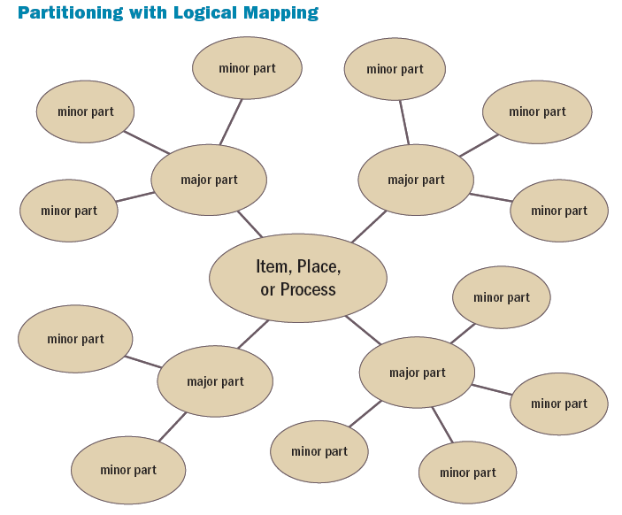

Slide 23
Organizing and Drafting
Use a Specific and Precise Title
Include an Introduction with an Overall Description
Include a Description by Features, Functions, or Stages
Include a Description by Senses, Similes, Analogies, and Metaphors
Conclude
Notes:
Use a specific and precise title – title should clearly identify the purpose of the document.
Include an introduction with an overall description – set a framework or context by including some or all of the following features:
Definition of subject
Purpose statement
Main point
Importance of subject
Overall description of subject
List of major features, functions, or stages
Include a description by features, functions, or stages – address each major part, identify and describe minor parts.
Include a description by senses (five senses,) similes (“A is like B”,) analogies (“A is to B as C is to D”,) and metaphors (saying “A is B”)
Conclusion should be short and concise

Slide 24
Help: Using Digital Photography in Descriptions
Insert Visuals into Your Descriptions
Consider
Resolution
ISO sensitivity (not to be confused with ISO Standards which are something completely different!)
Shutter speed
Cropping
Notes:
Resolution
Digital cameras allow you to set resolution. Smaller is better for quick downloads. Larger is better for printing. .jpeg or .png format are usually best for online. .tiff files are best for printing.
ISO sensitivity
ISO is the amount of light the camera picks up.
Shutter speed
Shutter speed determines how much light is allowed into the camera when you push the button.
Cropping
Cropping removes things you don’t want from a photo.

Slide 25

Using photographs…
Can enhance the readability of your document
Create life-like image quality
Use high resolutions for print and lower resolutions for web

Slide 26
Using Style and Design
Style Should Be Simple and Straightforward
Design Should Clarify and Support the Text
Plain, simple style
Page layout that fits
Graphics that illustrate
Notes:
Plain, simple style
Use simple words and limit jargon
Focus on need-to-know details
Keep sentences short
Remove subjective qualifiers
Use senses to add detail
Page layout that fits
Use two or three-column format to leave room for images.
List any minor parts in bulleted lists.
Add a sidebar that draws attention to an important part or feature.
Use headings to clarify organization.
Put measurements in a table.
Graphics that illustrate – pictures, illustrations, and diagrams help readers visualize your subject and its parts.
Use a title and figure number with each graphic.
Refer to the graphic by number in the written text.
Include captions that explain what the graphic shows.
Label specific features in the graphic.
Place the graphic on the page where it is referenced or soon afterward.

Slide 27
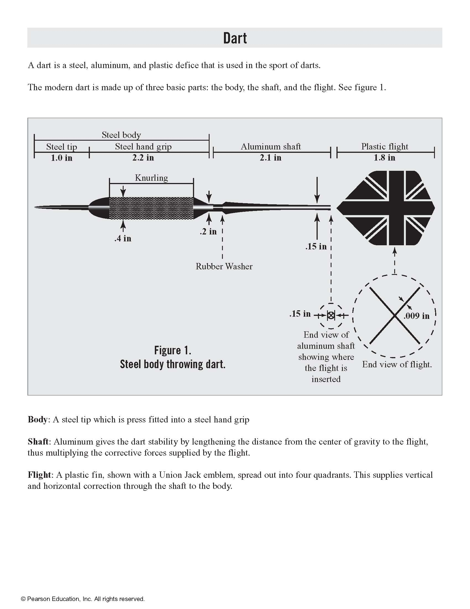
Team Self-Reflection
Who is the intended audience?
How is the information organized?
What is the level of specificity?
Compare this technical description with your team’s.
Where do they differ?

Slide 28
Unit 6 Assignments: See Arisoph for details
Team Assignment: Create a technical description
  DEADLINE has CHANGED! Due Friday, November 15, 11:55 p.m.
Individual Audience Analysis Reflection
  DEADLINE has CHANGED! Due Sunday, November 17, 11:55 p.m.
Reading Check (individual assignment) Due November 17, 11:55 p.m.

